Slide 2
INDIA - New Delhi - The World’s largest democracy
The CII AGM for 2015 is going to be held in New Delhi from the 20th October to 25th October 2015. This is the peak season month and the weather in mid October is delightful, which ranges from 34-18 centigrade which works to 93-65 degrees Fahrenheit.
New Delhi, India’s capital is sprinkled with glittering gems: captivating ancient monuments, magnificent museums, a vivacious performing-arts scene and some of the subcontinent’s yummiest places to eat.

Slide 3
Fourth best airport in the World
Almost all the major International airlines have their flights operating directly to and from Indira Gandhi International Airport at New Delhi.

Slide 4
HOST HOTEL – THE GRAND

Slide 5
Crystal Lounge

Slide 6
Conference Hall

Slide 7
Ballroom

Slide 8
BOARDROOM

Slide 9
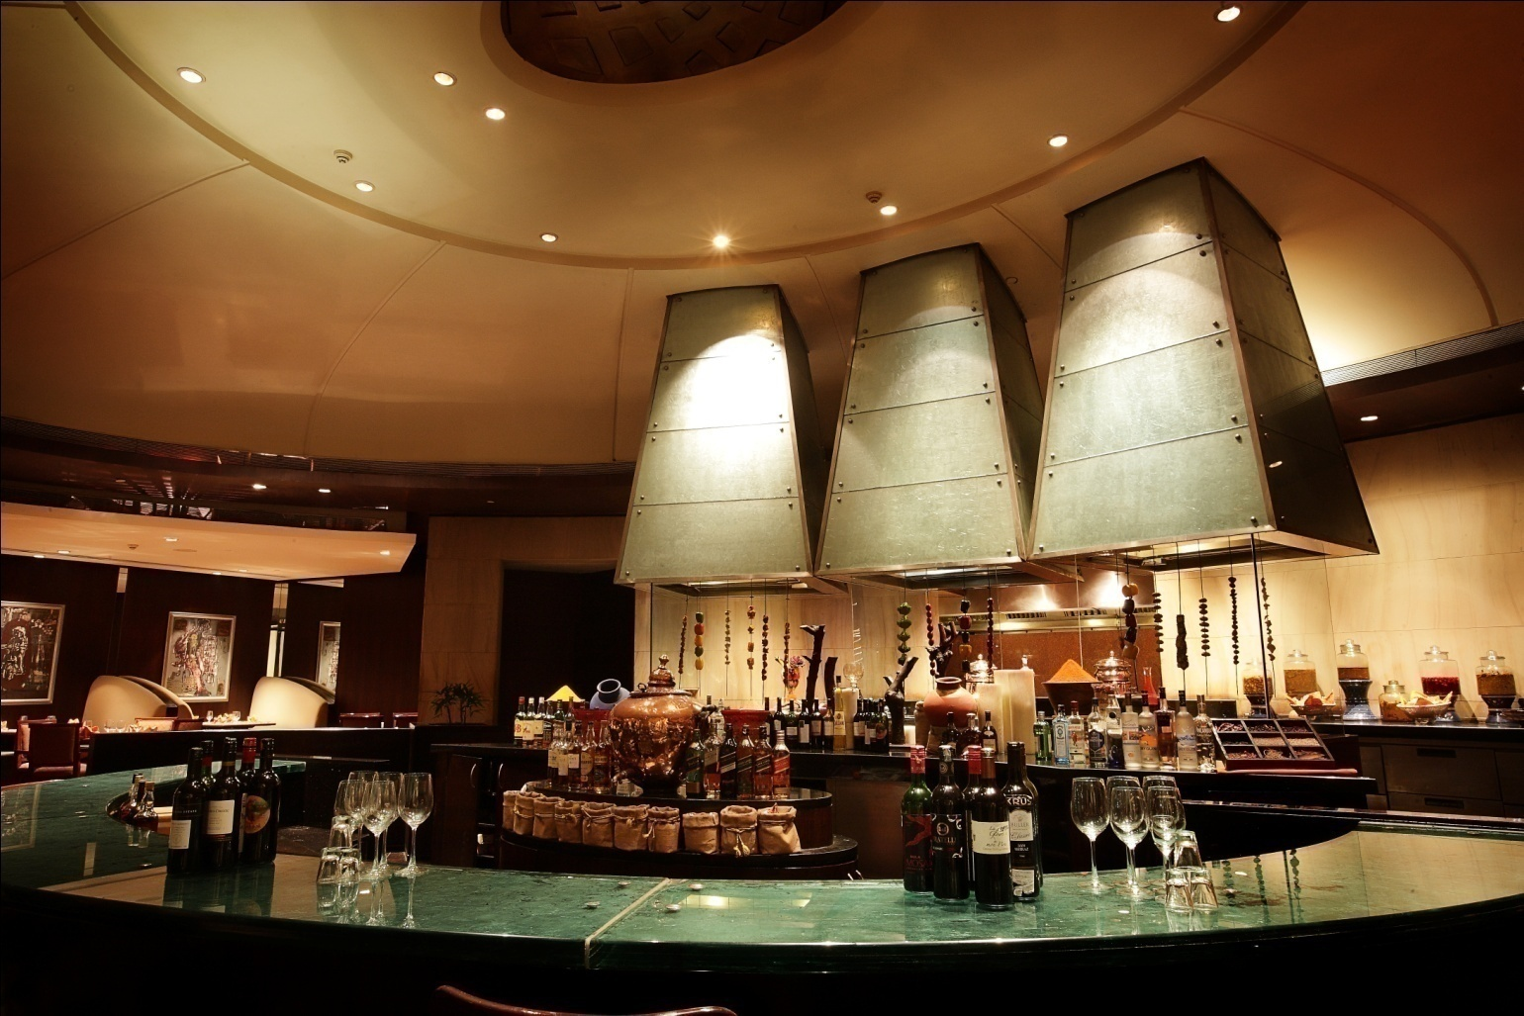
Caraway

Slide 10
Hospitality Suite

Slide 11
SPA

Slide 12
Gym

Slide 13
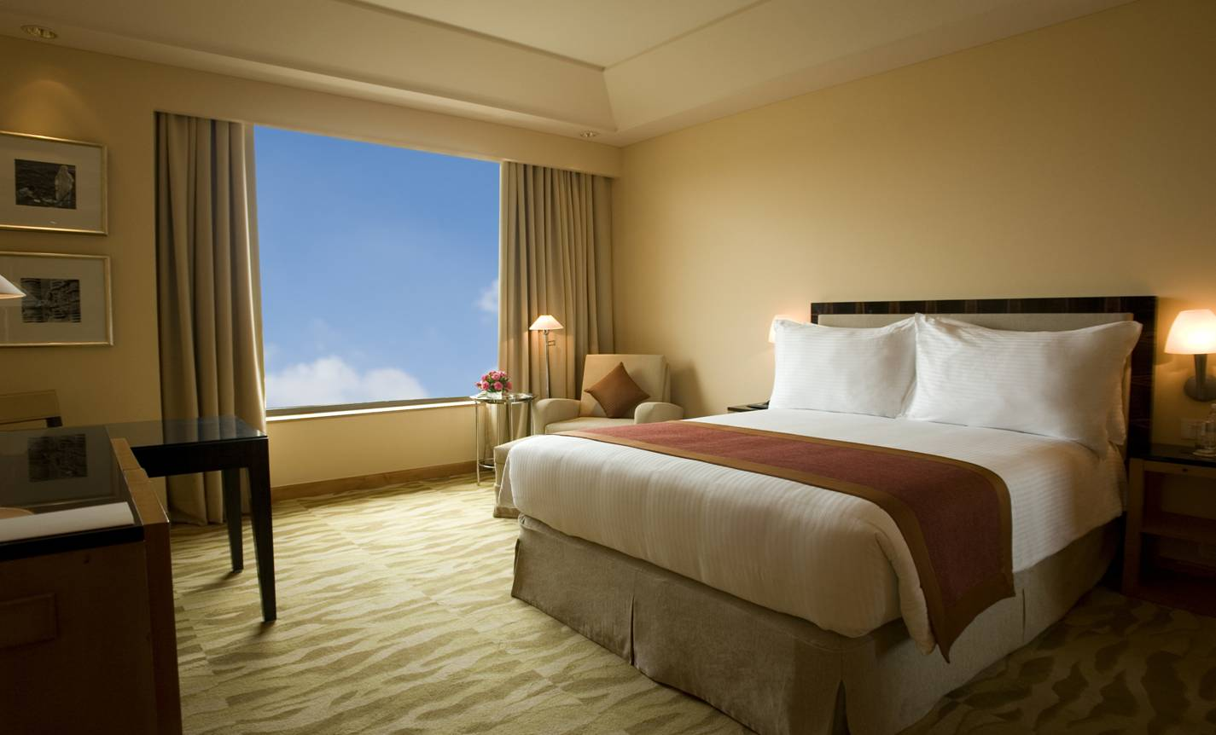
Premium Room

Slide 14
Premium Room
USD 135 for double occupancy inclusive of all taxes.
Benefits with Premium Room:
Buffet Breakfast at Cascades restaurant
Unlimited Wifi
Complimentary usage of "Spa Oasis" Fitness Center including Cardio, weight equipment and swimming pool.
25% discount on laundry, spa, food and all beverages, room service, restaurants and mini bar.
In room safe and tea / coffee facilities.
Two bottles of Mineral water on daily basis.
Fruits basket on daily basis

Slide 15
CII AGM Provisional Schedule
Tuesday, October 20
7:30 AM—9:00 AM Breakfast
9:00 AM—5:00 PM Registration
9:30 AM—1:00 PM Board of Directors’ Meeting
1:00 PM—3:30 PM Board Lunch
1:30 PM—6:00 PM Golf Outing (Optional)
7:00 PM—9:00 PM Opening Cocktail/Dinner Reception
9:00 PM—11:00 PM Hospitality Suite
Wednesday October 21
7:30 AM—9:00 AM Breakfast
9:00 AM—10:00 AM Opening Ceremony
9:30 AM—1:30PM Spouse Tour
10:30 AM —1:30 PM Seminars
1:30 PM—2:30 PM Lunch
2:30 PM—7:30 PM Akshardham Tour (Tentative)
7:00 PM—10:00 PM Dinner
10:00 PM—11:30 PM Hospitality Suite

Slide 16
CII AGM Provisional Schedule
Thursday, October 22
7:30 AM—9:00 AM Breakfast
9:00 AM—1:00 PM Annual General Meeting
9:30 AM—1:30 PM Spouse Tour w/lunch
1:00 PM—3:00 PM Awards Luncheon
4:00 PM—10:00 PM Kingdom of Dreams (tentative)
10:00 PM—11:30 PM Hospitality Suite
Friday, October 23
7:30 AM—9:00 AM Breakfast
9:00 AM—12:30PM Seminars
1:00 PM—2:30 PM Lunch
3:00 PM—4:30 PM New Board Meeting
7:00 PM—11:00 PM Gala Banquet
11:00 PM Hospitality Suite

Slide 17
CII AGM Provisional Schedule
Saturday, October 24 Grand tour day – Taj Mahal
7:00 AM—8:00 AM Breakfast
8:00 AM—9:00 PM Tour Taj Mahal in Agra (Optional)
9:00 PM— Hospitality Suite

Slide 18
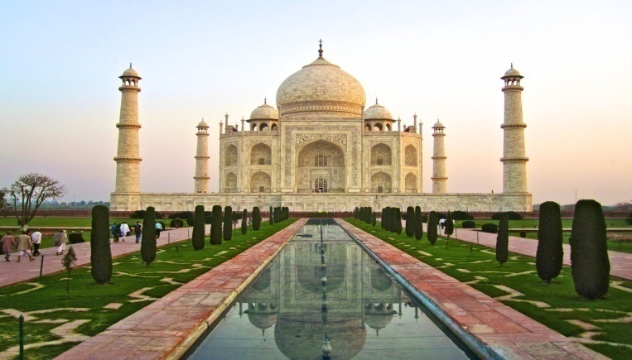
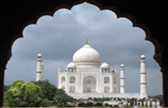
Seventh Wonder of the World
The Taj Mahal is a white marble mausoleum located in Agra, Uttar Pradesh, India. It was built by Mughal emperor Shah Jahan in memory of his third wife, Mumtaz Mahal. The Taj Mahal is widely recognized as "The jewel of Muslim art in India and one of the universally admired masterpieces of the world's heritage“ It is a UNESCO World Heritage Site.

Slide 19
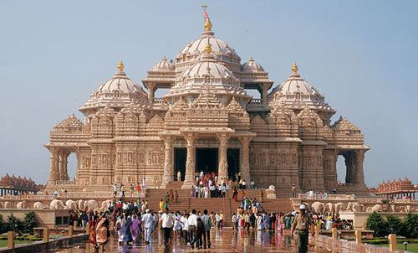
World’s Largest Hindu Temple
Akshardham Temple in New Delhi epitomizes 10,000 years of Indian culture. It brilliantly showcases the essence of India’s ancient architecture, traditions and timeless spiritual messages. The Akshardham experience is an enlightening journey through India’s glorious art, values and contributions for the progress, happiness and harmony of mankind.
It holds the Guinness world record as the World's Largest Comprehensive Hindu Temple.

Slide 20
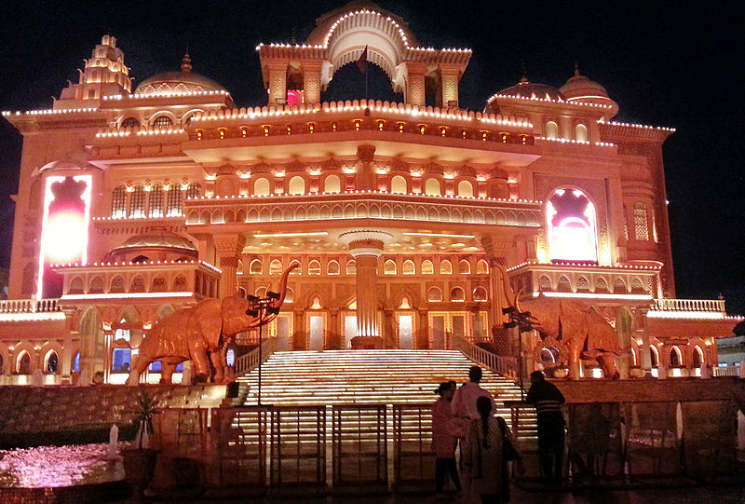
Zangoora - the Gypsy Prince
India's answer to Broadway, “Zangoora - the Gypsy Prince" - The biggest Bollywood musical ever. Introducing a brand new genre of entertainment where storytelling & Bollywood style Song & Dance meet stagecraft and technical wizardry like never seen before.

Slide 21
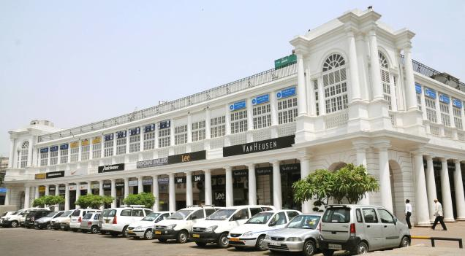
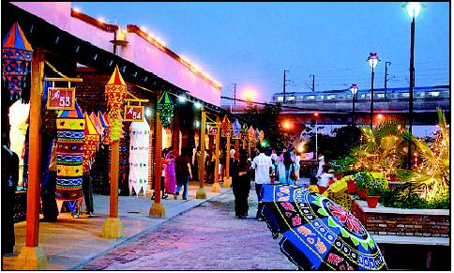
Places to Shop
Connaught Place
Dilli Haat

Slide 22
Places to Shop
Emporio Mall – high end shopping

Slide 23
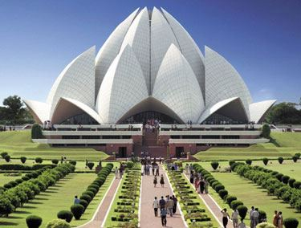
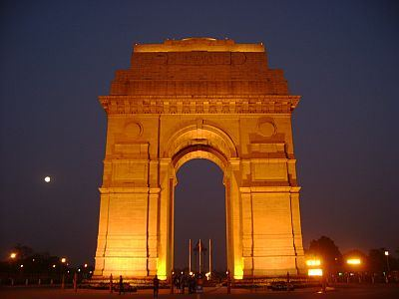
Historical Monuments
Lotus Temple
India Gate

Slide 24
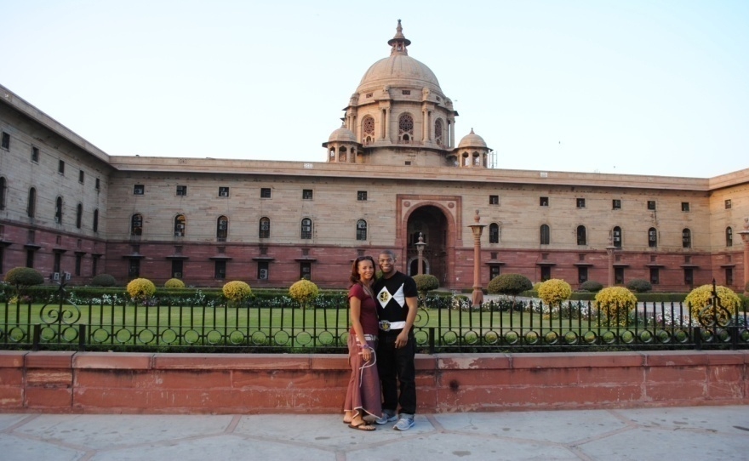
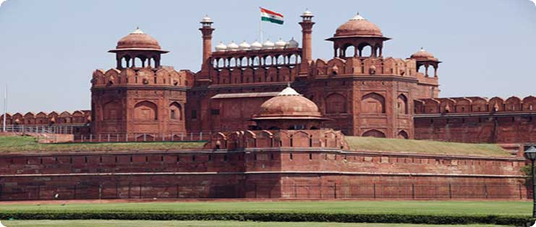
Historical Monuments
Rashtrapati Bhawan
Red Fort

Slide 25
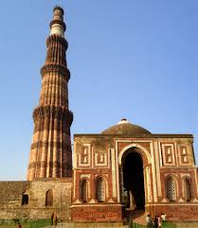
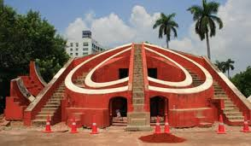
Historical Monuments
Jantar Mantar
Qutub Minar

Slide 26
COMMERCIALS
Rooms USD 135 for double occupancy with breakfast , unlimited wifi and inclusive of all taxes
Airport Transfer USD 34 to and fro (return)
Registration Fee USD 450 to include all tours, transport, lunches, dinners and drinks
Golf USD 50 approx.
Taj Mahal USD 125 approx. to include
(Agra Tour) transport and lunch

